Slide 1
Introduction to the EGI cloud federations
Giuseppe La Rocca giuseppe.larocca@egi.eu Technical Outreach Expert
Webinar: https://indico.egi.eu/indico/event/3522/

Slide 2
EGI: Advanced Computing for Research

Slide 3
EGI Stakeholders
Major national e-Infrastructures: 22 NGIs
EIRO: CERN (European Intergovernmental Research Organisation)
Membership fees sustain the federation and community

Slide 4
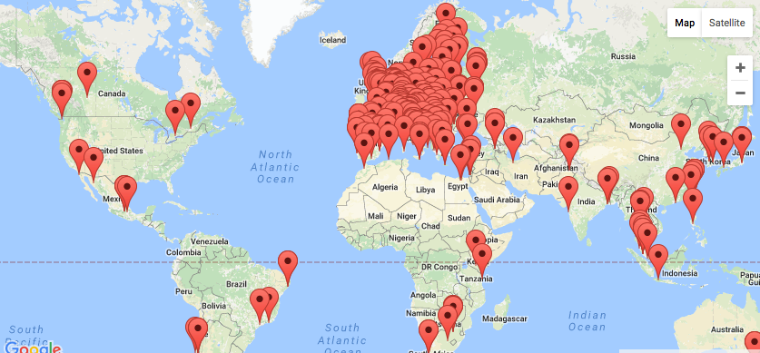
EGI today
EGI Foundation (Amsterdam)
730,000 CPU Cores
650 PB of disk and tape storage
20 Cloud providers
325 resource providers
61,000 users
5,000 research papers

Slide 5
EGI serves researchers and innovators
Size of individual groups
WLCG
ELI
CTA
ELIXIR
EPOS
EISCAT_3D
BBMRI
CLARIN
LOFAR
EMSO
LifeWatch
ICOS
EMSO
CORBEL
ENVRIplus
…
VRE projects
OpenDreamKit
WeNMR
DRIHM
VERCE
MuG
AgINFRA
CMMST
LSGC
SuperSites Exploitation
Environmental sci.
neuGRID
…
PeachNote
CEBA Galaxy eLab
Semiconductor design
Main-belt comets
Quantum pysics studies
Virtual imaging (LS)
Bovine tuberculosis spread
Convergent evol. in genomes
Geography evolution
Seafloor seismic waves
3D liver maps with MRI
Metabolic rate modelling
Genome alignment
Tapeworms infection on fish
…
Agroknow
CloudEO
CloudSME
Ecohydros
gnubila
Sinergise
SixSq
TEISS
Terradue
Ubercloud
…
ESFRIs, FET flagships
Multinational communities, (e.g. H2020 projects)
Industry, SMEs
‘Long tail of science’

Slide 6
Access to resources: Virtual Organisations
VO 1 (site a, b, c)
VO 2 (site x, y, z, b)
Generic VOs – such as fedcloud.egi.eu → Test VOs, “incubator” for new users
Community/discipline-specific VOs – e.g. Chipster, Highthroughtputseq, EISCAT, etc.
Training VO = training.egi.eu → Running hands on training in the cloud (about any software!)
Browse and search VOs at http://operations-portal.egi.eu/vo/search

Slide 7
The EGI Federated Cloud Infrastructure
Grid of clouds
Unified user interfaces
Harmonised operational behaviour
Clouds and their interconnections are based on open standards, open technologies

Slide 8
The EGI IaaS Federated Cloud Model
EGI AAI
Community Platforms
AppDB VMOps
IaaS Federated Access Tools
IaaS API
IaaS API
IaaS API
Cloud Management Framework
Cloud Management Framework
Cloud Management Framework
EGI Federation services:
Accounting, Monitoring, Configuration Database, Information Discovery, VM Marketplace

Slide 9
Value propositions of the EGI IaaS FedCloud
Users achieve application portability
Single-Sign On via Check-in
Unified interfaces
Discovery of resources
Appliance library and secure distribution
User-friendly GUI
Providers join a reliable infrastructure
Support international communities
Operational and security processes
A/R Monitoring
Accounting
Technology agnostic

Slide 10
Typical usage models
Compute and data intensive workloads
Batch and interactive (e.g. Jupyter notebook) with scalable and customized environments
Examples: The Genetics of Salmonella Infections, The Chipster platform
Service Hosting
Long-running services (e.g. web server, database, application server)
Examples: NBIS Web Services, Peachnote analysis platform, The VERCE platform
Datasets repository
Store and manage large datasets (in a storage volume)
Disposable and testing environments
Host training environments, test applications
Examples:
Events conducted on the cloud-based EGI Training Infrastructure

Slide 11
The EGI FedCloud Infrastructure
20 resource centres
5 centres under integration
15 OpenStack
4 OpenNebula
1 Synnefo
2 centres expressed interest on joining

Slide 12
Access modes
Open Standards Realm
Uses OCCI 1.2 interface
Ruby and Java SDKs available
Simple CLI tool for managing resources
OpenStack Realm
Native OpenStack API with VOMS AuthN/AuthZ
Plugin for python SDK and OpenStack CLI

Slide 13
Links
EGI Federated Cloud Infrastructure:
https://wiki.egi.eu/wiki/EGI_Federated_Cloud
How to access the EGI Federated Cloud Infrastructure:
https://wiki.egi.eu/wiki/Federated_Cloud_user_support#Getting_started
Support: support@egi.eu

