Slide 1
Distributed Computing Framework
A. Tsaregorodtsev,
CPPM-IN2P3-CNRS, Marseille EGI Webinar, 7 June 2016

Slide 2
Plan
DIRAC Project
Origins
Agent based Workload Management System
Accessible computing resources
Data Management
Interfaces
DIRAC users
DIRAC as a service
Conclusions
Notes:
Qui a besoin de plus qu’un seul ordinateurs pour le travail ?

Slide 3
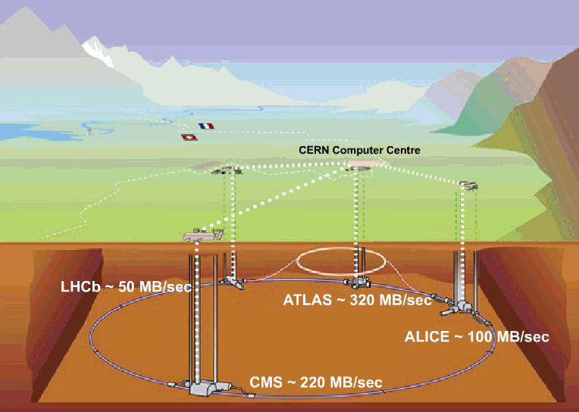
Data flow to permanent storage: 6-8 GB/sec
400-500 MB/sec
1-2 GB/sec
~ 4 GB/sec
1-2 GB/sec

Slide 4
Worldwide LHC Computing Grid Collaboration (WLCG)
>100 PB of data at CERN and major computing centers
Distributed infrastructure of 150 computing centers in 40 countries
300+ k CPU cores (~ 2M HEP-SPEC-06)
The biggest site with ~50k CPU cores, 12 T2 with 2-30k CPU cores
Distributed data, services and operation infrastructure

Slide 5
DIRAC Grid Solution
LHC experiments, all developed their own middleware to address the above problems
PanDA, AliEn, glideIn WMS, PhEDEx, …
DIRAC is developed originally for the LHCb experiment
The experience collected with a production grid system of a large HEP experiment is very valuable
Several new experiments expressed interest in using this software relying on its proven in practice utility
In 2009 the core DIRAC development team decided to generalize the software to make it suitable for any user community.
Consortium to develop, maintain and promote the DIRAC software
CERN, CNRS, University of Barcelona, IHEP, KEK
The results of this work allow to offer DIRAC as a general purpose distributed computing framework

Slide 6
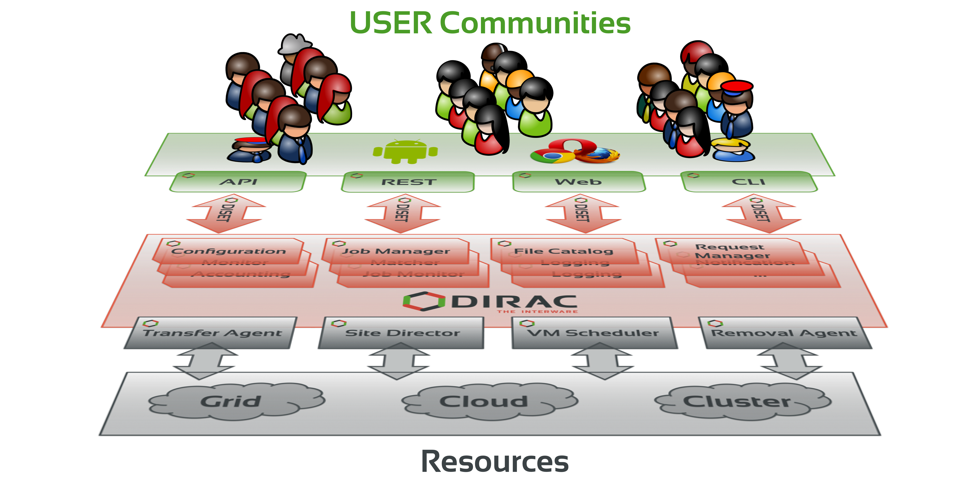
Interware
DIRAC provides all the necessary components to build ad-hoc grid infrastructures interconnecting computing resources of different types, allowing interoperability and simplifying interfaces. This allows to speak about the DIRAC interware.

Slide 7
DIRAC Workload Management

Slide 8
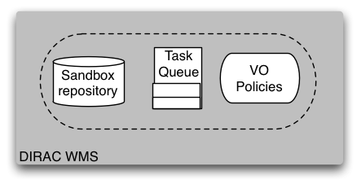
Physicist
User
Production
Manager
Matcher
Service
EGI/WLCG
Grid
NDG
Grid
Amazon EC2 Cloud
CREAM
CE
EGI
Pilot
Director
NDG
Pilot
Director
Amazon
Pilot
Director
CREAM
Pilot
Director

Slide 9
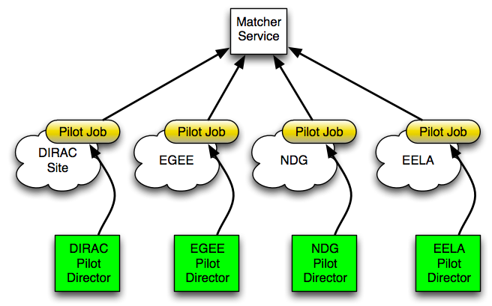
WMS: using heterogeneous resources
Including resources in different grids and standalone clusters is simple with Pilot Jobs
Needs a specialized Pilot Director per resource type
Users just see new sites appearing in the job monitoring

Slide 10
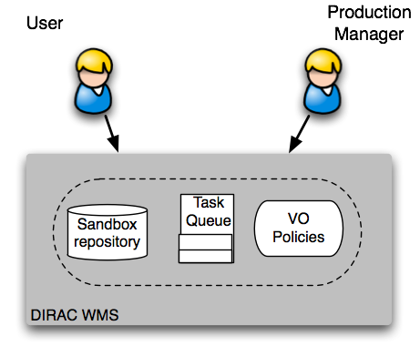
WMS: applying VO policies
In DIRAC both User and Production jobs are treated by the same WMS
Same Task Queue
This allows to apply efficiently policies for the whole VO
Assigning Job Priorities for different groups and activities
Static group priorities are used currently
More powerful scheduler can be plugged in
demonstrated with MAUI scheduler
Users perceive the DIRAC WMS as a single large batch system

Slide 11
DIRAC computing resources

Slide 12
Computing Grids
DIRAC was initially developed with the focus on accessing conventional Grid computing resources
WLCG grid resources for the LHCb Collaboration
It fully supports gLite middleware based grids
European Grid Infrastructure (EGI), Latin America GISELA, etc
Using gLite/EMI middleware
Northern American Open Science Grid (OSG)
Using VDT middleware
Northern European Grid (NDGF)
Using ARC middleware
Other types of grids can be supported
As long we have customers needing that

Slide 13
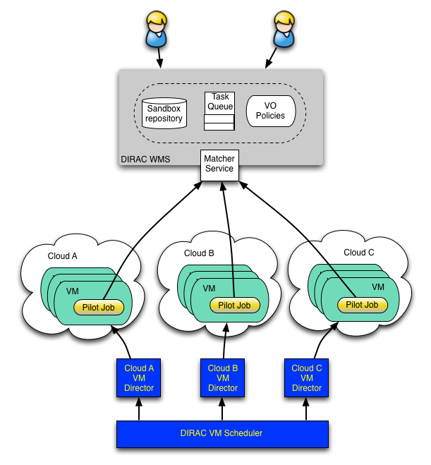
Clouds
VM scheduler developed for Belle MC production system
Dynamic VM spawning taking Amazon EC2 spot prices and Task Queue state into account
Discarding VMs automatically when no more needed
The DIRAC VM scheduler by means of dedicated VM Directors is interfaced to
OCCI compliant clouds:
OpenStack, OpenNebula
CloudStack
Amazon EC2

Slide 14
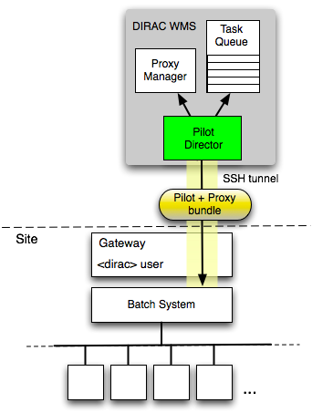
Standalone computing clusters
Off-site Pilot Director
Site delegates control to the central service
Site must only define a dedicated local user account
The payload submission through the SSH tunnel
The site can be a single computer or a cluster with a batch system
LSF, BQS, SGE, PBS/Torque, Condor, OAR, SLURM
HPC centers
More to come:
LoadLeveler. etc
The user payload is executed with the owner credentials
No security compromises with respect to external services

Slide 15
Data Management

Slide 16
DM Problem to solve
Data is partitioned in files
File replicas are distributed over a number of Storage Elements world wide
Data Management tasks
Initial File upload
Catalog registration
File replication
File access/download
Integrity checking
File removal
Need for transparent file access for users
Often working with multiple ( tens of thousands ) files at a time
Make sure that ALL the elementary operations are accomplished
Automate recurrent operations

Slide 17
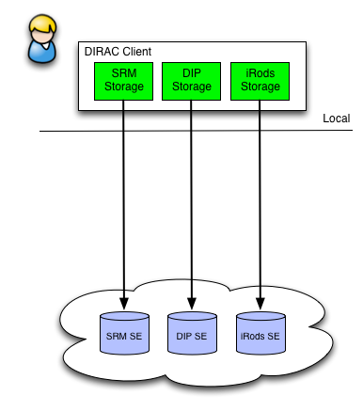
Storage plugins
Storage element abstraction with a client implementation for each access protocol
DIPS, SRM, XROOTD, RFIO, etc
gfal2 based plugin gives access to all protocols supported by the library
DCAP, WebDAV, S3, http, …
iRODS
Each SE is seen by the clients as a logical entity
With some specific operational properties
SE’s can be configured with multiple protocols

Slide 18
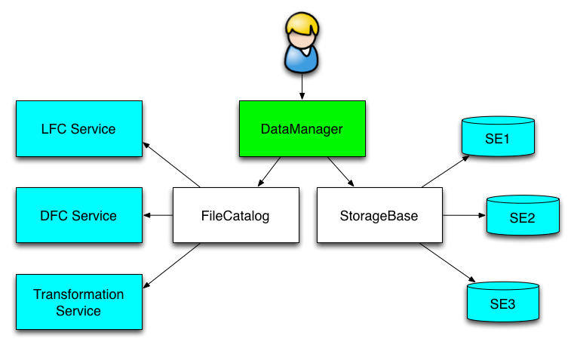
File Catalog
Central File Catalog ( DFC, LFC, … )
Keeps track of all the physical file replicas
Several catalogs can be used together
The mechanism is used to send messages to “pseudocatalog” services, e.g.
Transformation service (see later)
Bookkeeping service of LHCb
A user sees it as a single catalog with additional features
DataManager is a single client interface for logical data operations

Slide 19
File Catalog
DFC is the central component of the DIRAC Data Management system
Defines a single logical name space for all the data managed by DIRAC
Together with the data access components DFC allows to present data to users as single global file system
User ACLs
Rich metadata including user defined metadata

Slide 20
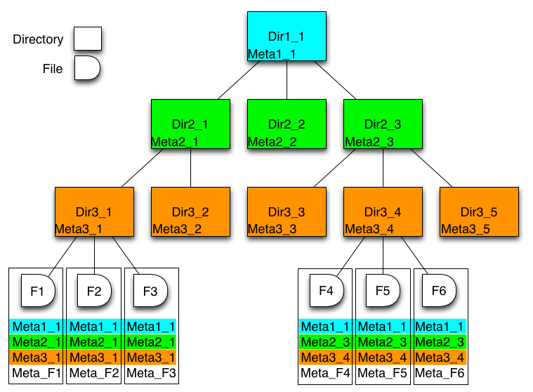
File Catalog: Metadata
DFC is Replica and Metadata Catalog
User defined metadata
The same hierarchy for metadata as for the logical name space
Metadata associated with files and directories
Allow for efficient searches
Efficient Storage Usage reports
Suitable for user quotas
Example query:
find /lhcb/mcdata LastAccess < 01-01-2012 GaussVersion=v1,v2 SE=IN2P3,CERN Name=*.raw

Slide 21
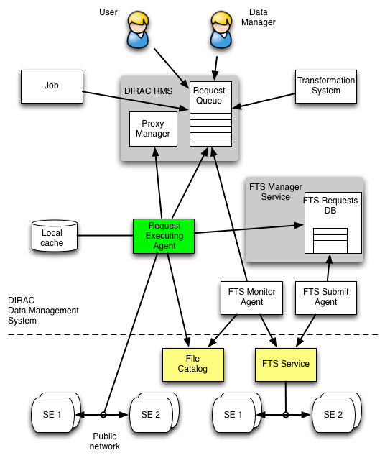
Bulk data transfers
Replication/Removal Requests with multiple files are stored in the RMS
By users, data managers, Transformation System
The Replication Operation executor
Performs the replication itself or
Delegates replication to an external service
E.g. FTS
A dedicated FTSManager service keeps track of the submitted FTS requests
FTSMonitor Agent monitors the request progress, updates the FileCatalog with the new replicas
Other data moving services can be connected as needed
EUDAT
Onedata

Slide 22
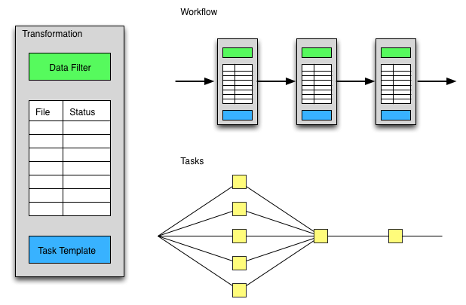
Transformation System
Data driven workflows as chains of data transformations
Transformation: input data filter + recipe to create tasks
Tasks are created as soon as data with required properties is registered into the system
Tasks: jobs, data replication, etc
Transformations can be used for automatic data driven bulk data operations
Scheduling RMS tasks
Often as part of a more general workflow

Slide 23
Interfaces

Slide 24
DM interfaces
Command line tools
Multiple dirac-dms-… commands
COMDIRAC
Representing the logical DIRAC file namespace as a parallel shell
dls, dcd, dpwd, dfind, ddu etc commands
dput, dget, drepl for file upload/download/replication
REST interface
Suitable for use with application portals
WS-PGRADE portal is interfaced with DIRAC this way

Slide 25
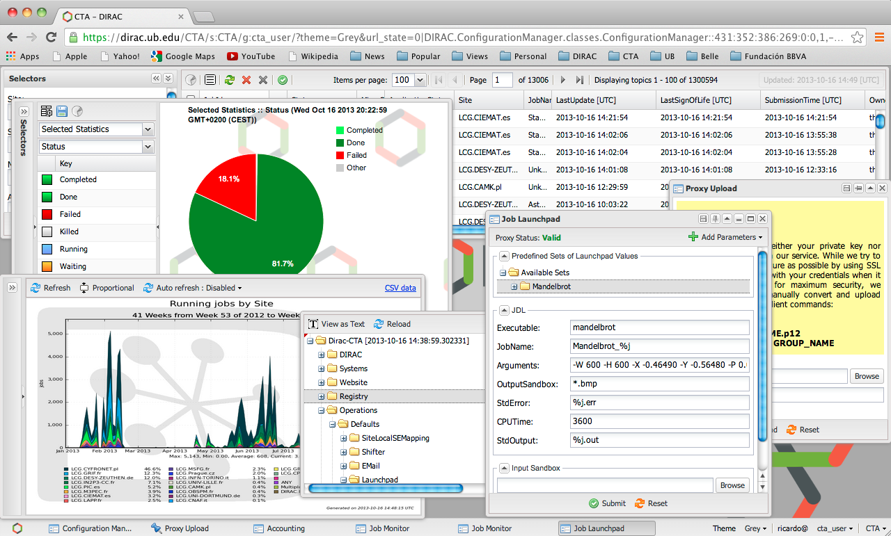
Web Portal

Slide 26
Distributed Computer
DIRAC is aiming at providing an abstraction of a single computer for massive computational and data operations from the user perspective
Logical Computing and Storage elements (Hardware )
Global logical name space ( File System )
Desktop-like GUI

Slide 27
DIRAC Users

Slide 28
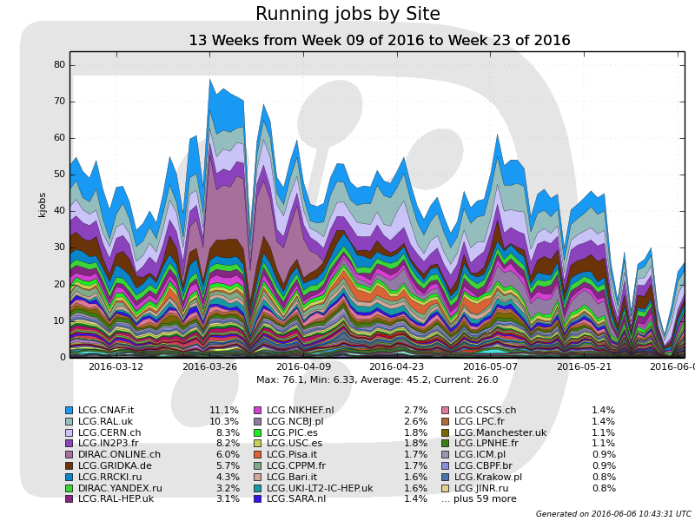
LHCb Collaboration
Up to 100K concurrent jobs in ~120 distinct sites
Equivalent to running a virtual computing center with a power of 100K CPU cores
Further optimizations to increase the capacity are possible
Hardware, database optimizations, service load balancing, etc

Slide 29
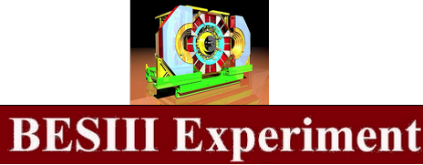
Community installations
Belle II Collaboration, KEK
First use of clouds (Amazon) for data production
ILC/CLIC detector Collaboration, Calice VO
Dedicated installation at CERN, 10 servers, DB-OD MySQL server
MC simulations
DIRAC File Catalog was developed to meet the ILC/CLIC requirements
BES III, IHEP, China
Using DIRAC DMS: File Replica and Metadata Catalog, Transfer services
Dataset management developed for the needs of BES III
CTA
CTA started as France-Grilles DIRAC service customer
Now is using a dedicated installation at PIC, Barcelona
Using complex workflows
Geant4
Dedicated installation at CERN
Validation of MC simulation software releases
DIRAC evaluations by other experiments
LSST, Auger, TREND, Daya Bay, Juno, ELI, NICA, …
Evaluations can be done with general purpose DIRAC services

Slide 30
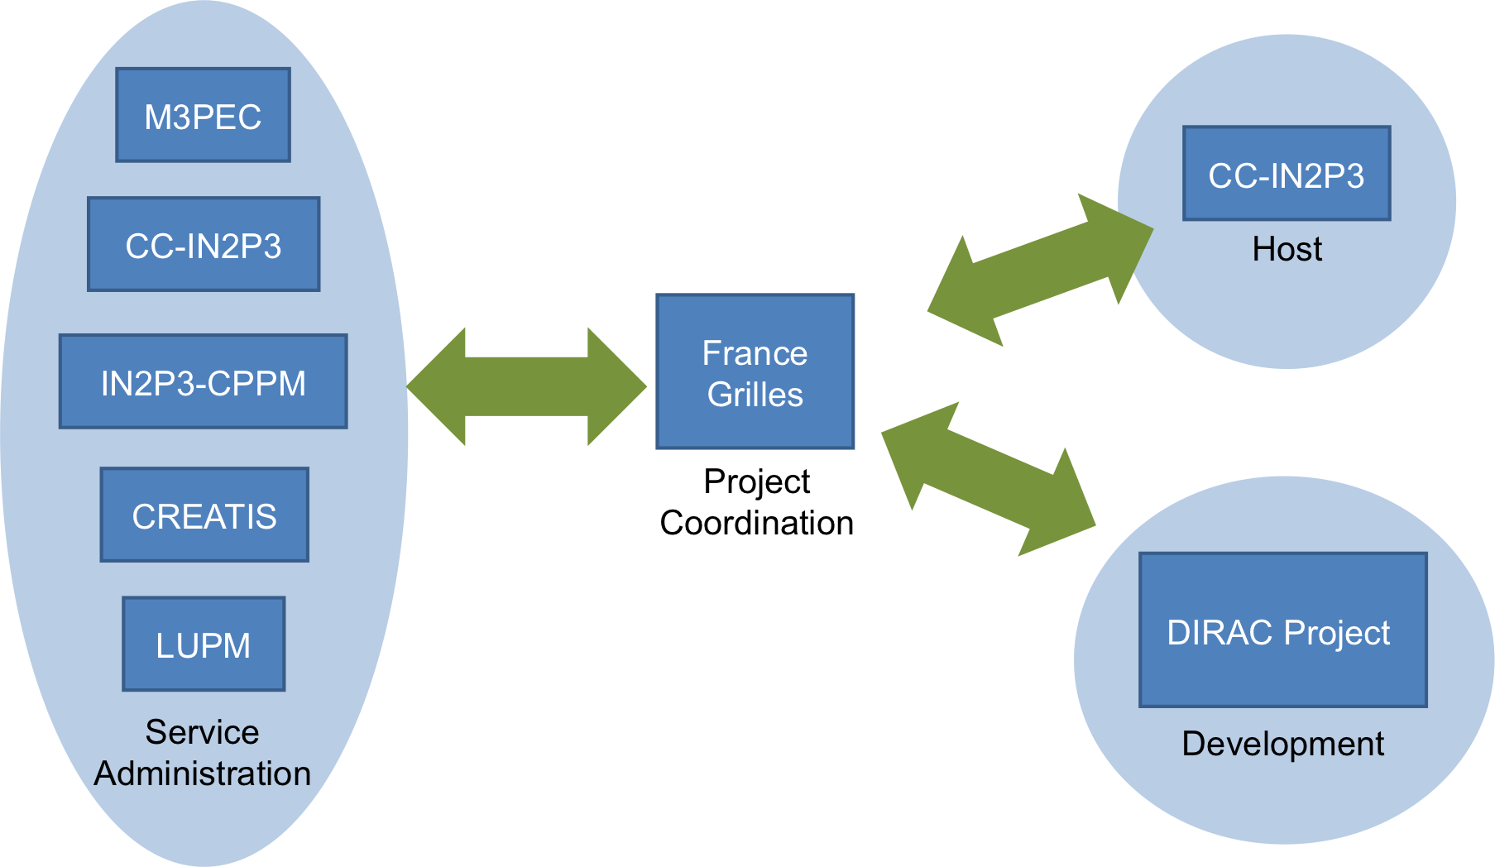
National services
DIRAC services are provided by several National Grid Initiatives: France, Spain, Italy, UK, China, …
Support for small communities
Heavily used for training and evaluation purposes
Example: France-Grilles DIRAC service
Hosted by the CC/IN2P3, Lyon
Distributed administrator team
5 participating universities
15 VOs, ~100 registered users
In production since May 2012
>12M jobs executed in the last year
At ~90 distinct sites
http://dirac.france-grilles.fr

Slide 31
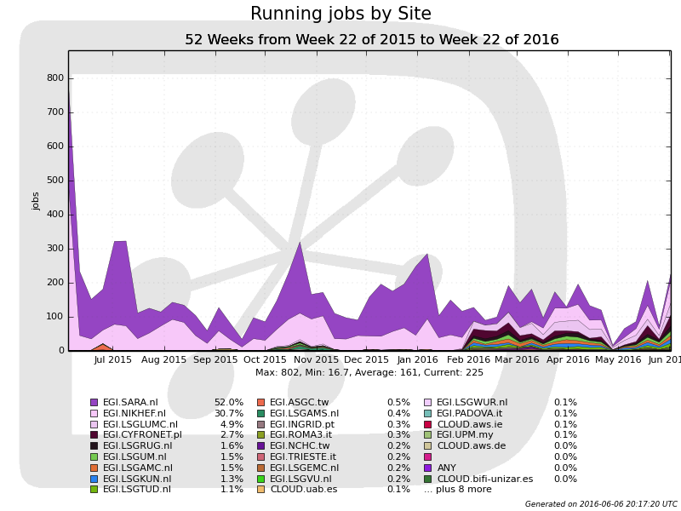
DIRAC4EGI service
In production since 2014
Partners
Operated by EGI
Hosted by CYFRONET
DIRAC Project providing software, consultancy
10 Virtual Organizations
enmr.eu
vlemed
eiscat.se
fedcloud.egi.eu
training.egi.eu
…
Usage
> 6 million jobs processed in the last year
DIRAC4EGI activity snapshot

Slide 32
DIRAC Framework

Slide 33
DIRAC Framework
DIRAC has a well defined architecture and development framework
Standard rules to create DIRAC extension
LHCbDIRAC, BESDIRAC, ILCDIRAC, …
Large part of the functionality is implemented as plugins
Almost the whole DFC service is implemented as a collection of plugins
Examples
Support for datasets first added to the BESDIRAC
LHCb has a custom Directory Tree module in the DIRAC File Catalog
Allows to customize the DIRAC functionality for a particular application with minimal effort

Slide 34
Conclusions
Computational grids and clouds are no more something exotic, they are used in a daily work for various applications
Agent based workload management architecture allows to seamlessly integrate different kinds of grids, clouds and other computing resources
DIRAC is providing a framework for building distributed computing systems and a rich set of ready to use services. This is used now in a number of DIRAC service projects on a regional and national levels
Services based on DIRAC technologies can help users to get started in the world of distributed computations and reveal its full potential
http://diracgrid.org

Slide 35
Demo

Slide 36
Demo
Using EGI sites and storage elements
Grid sites
Fed Cloud sites
DIRAC Storage Elements
Web Portal
Command line tools
Demo materials to try out off-line can be found here
https://github.com/DIRACGrid/DIRAC/wiki/Quick-DIRAC-Tutorial

